Slide 1
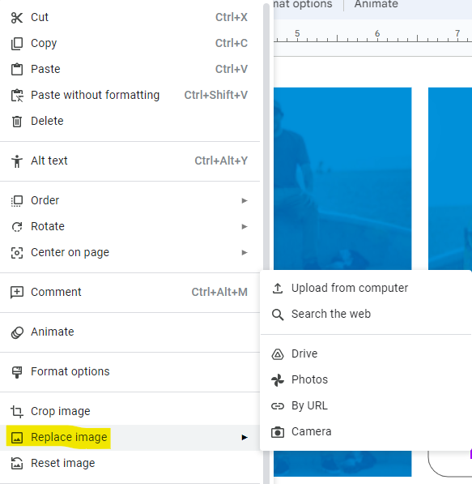
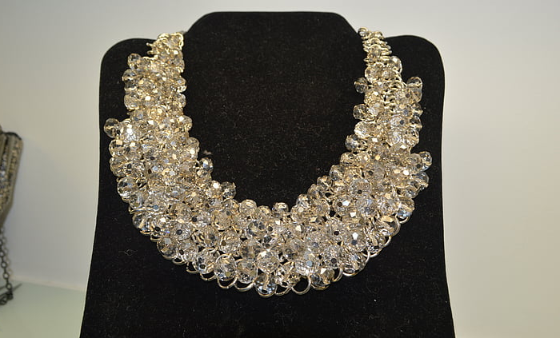

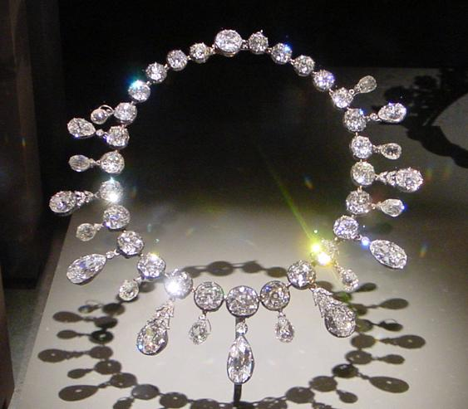
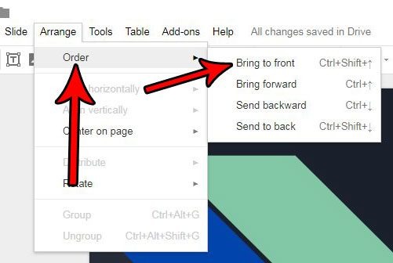
Collage Option Template
Right-click on an image, then select “Replace image” to replace the image with an image searched from the web or uploaded from your device. Repeat this process until your collage is complete.
Visualization of the Necklace in “The Necklace”

Slide 2

Use “Insert” then “Image” to search the web or to upload a file.

